Slide 1
Final Project Presentation: Students’ Financial Habits
Subject : Big Data Analysis
Team : The Girls !
Date : 26. 05. 2024

Slide 2
Structure
DataSet
Survey Result
Objectives
Data Analysis Tool
Analyses & Findings
Age, Aid, Income, & Tuition : Thiri Moe Htet (12214682)
School Year & Essential Spending: Thiri Moe Htet (12214682)
Preferred Payment Method & Spending: Simone Thurl (12240064)
Correlation between Housing & Rent Expense: Chaw Thiri San (12225272)
Housing & Financial Aid: Chaw Thiri San (12225272)

Slide 3
Survey Results
Total participants after data cleaning : 27 people (Male : 63%, Female : 37%, Non-binary : 0%)
Majors included:
ISE, IBT, Business, Nutrition, Computer Science, Politics & IR
Distribution across university year : Freshman (7.4%, Sophomore 44.4%, Junior: 37%, Senior : 11.1%)
Average costs
Monthly Income : $497, Housing :$316.72 , Food : $224.56, Transportation : $45, Education : $22, Entertainment : $106, Personal Care : $49, Tech tool : $28, Health Care : $41, Miscellaneous cost : $55.4

Slide 4
Objectives
To understand and do a comparative analysis highlighting similarities and differences in spending habits between Inha University students and the kaggle global dataset.
To identify clusters and patterns in spending habits.
To determine how different payment methods may impact on spending levels.
-> target group are students, especially from Inha University, to reflect and optimize their spending habits

Slide 5
Data Analysis Tools
We used ChatGPT to generate some ideas on how to analyze the data:
We used prompts like the following:
What important insight for students can we gain through data analysis of the following data?
Spending habits of 1000 students across different demographic groups and academic backgrounds Information such as age, gender, year in school, major, monthly income, financial aid received, and expenses in different spending categories Spending categories are tuition, housing, food, transportation, books & supplies, entertainment, personal care, technology, health & wellness, and miscellaneous expenses as well as preferred payment method for each students.
A survey with the same features was made at our university.
-> those helped us in deciding which prompts we would like to analyze to gain deeper insight into the topic

Slide 6
Data Analysis Tools
Extracting the survey data in an excel file
Uploading both data sources in Tableau
Joining both tables in order to get connections
Creating different calculated fields in order to use the data (eg. creating a general spending collum & averages)
Creating Graphs to understand the data by visualization

Slide 7
Age, Aid, Income & Tuition
Objective: To see how much tuition can be covered by aid and income while studying abroad. (Info for prospective students considering to study abroad)
Data Variables:
- Y-Axis : Average financial aid + average income - average tuition
- X-Axis: Age (international age)
Visualization Design: bar charts for clear representation of financial balances by age.

Slide 8
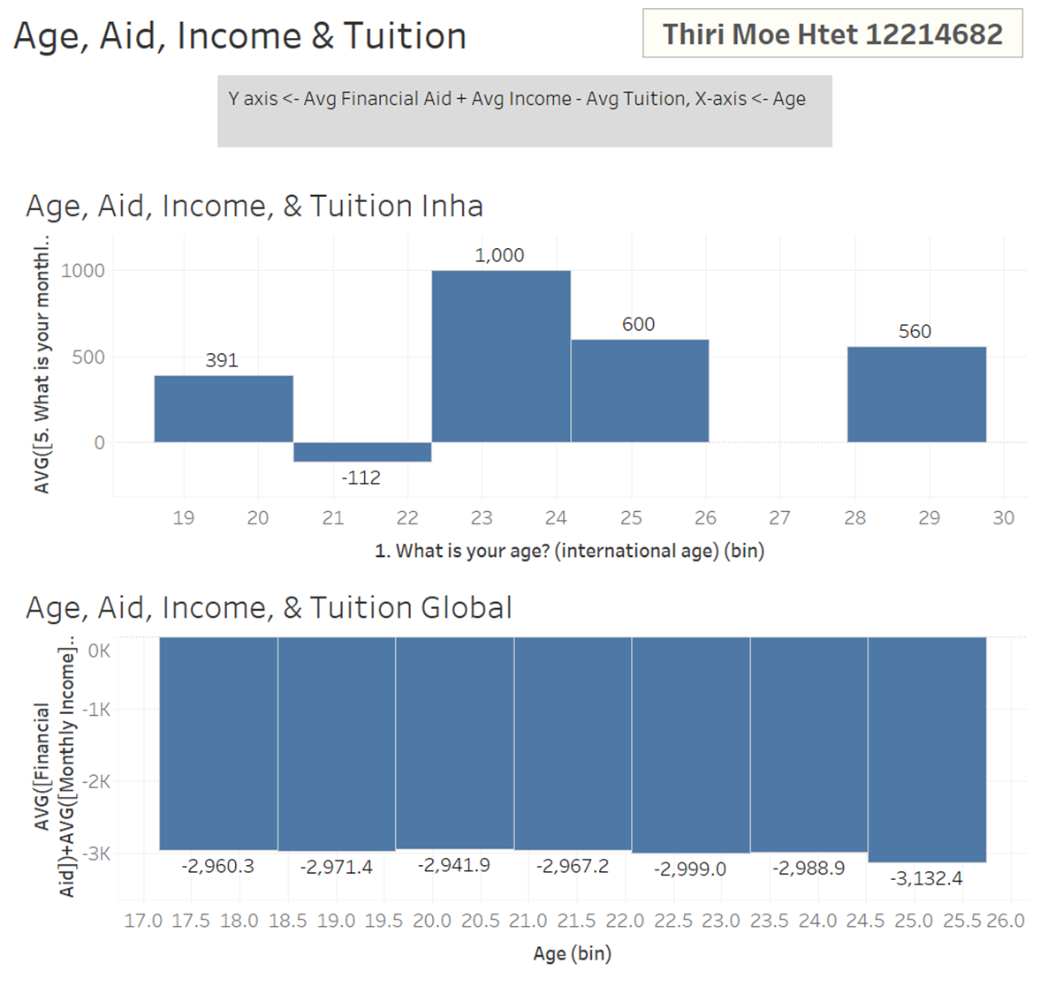
Results
Inha University appears to offer a more favorable financial situation to its students.
Younger students at Inha receive more financial support, which implies many international students gaining scholarships at admission.

Slide 9
School Year & Essential Spending
Objective:To examine how much essential spending varies across different years at university. (Info for post-admission students who are wondering how to allocate resources)
Categories:
- Essential Spending: Includes average book supplies, average housing, average transport, and average food.
-Present School Year
Visualization Design: bubble charts to depict essential spending across school years, with size indicating the amount spent.

Slide 10
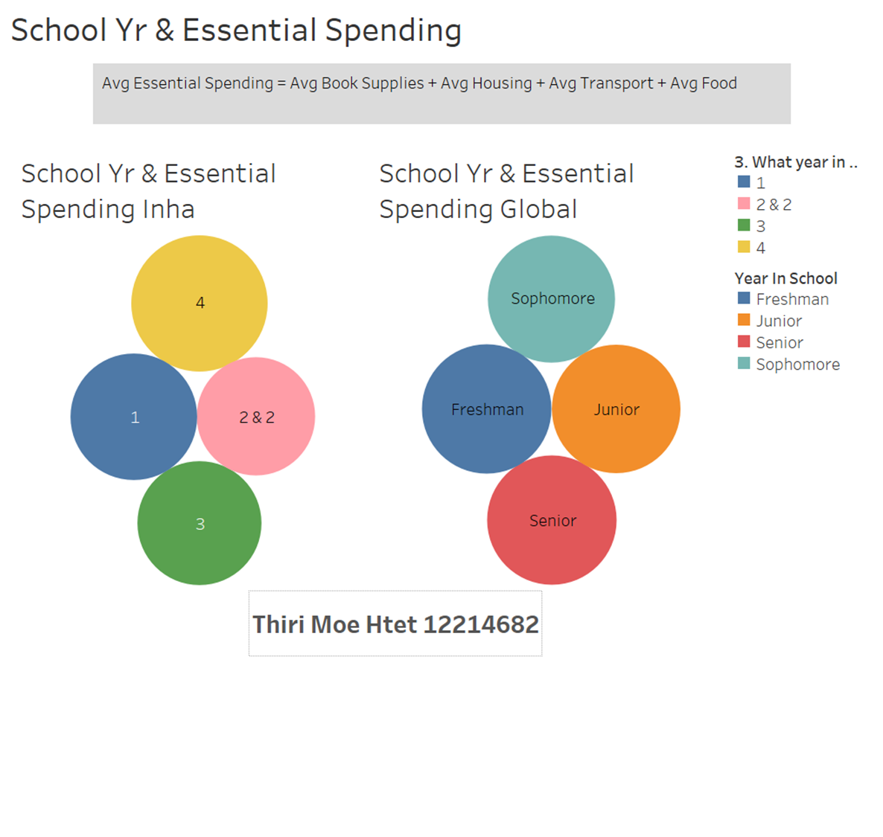
Results
Both at Inha University and globally, students experience higher costs in their initial and final years, requiring careful budgeting and resource management.

Slide 11
Preferred Payment Method & Spending
Objective:To examine if students typically safe money when using one specific form of payment and in order to recommend a payment method to students for saving money and to see if Inha students have a different pattern than the global students.
Categories:
- X-Axis: Average Spending: Food, Books & Supplies, Health & Wellness, Transportation, Entertainment, Personal Care, Technology and Miscellaneous
- X-Axis: Average Spending without necessities: Entertainment, Personal Care, Technology and Miscellaneous
- Y-Axis: Preferred Payment Method
Visualization Design: vertical bars to visualize the amount of money spent with each payment method

Slide 12
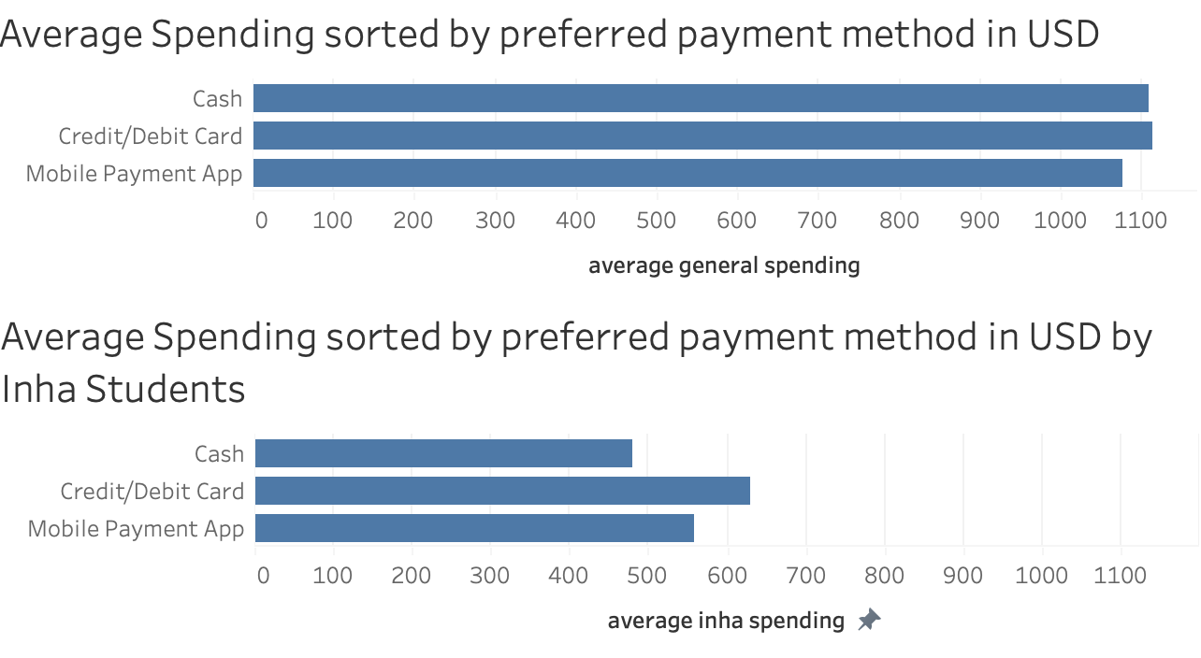
Results:
-> not a big difference between paying methods
-> Inha students spend slightly less money ($480 vs. $629 & $558) when using Cash

Slide 13
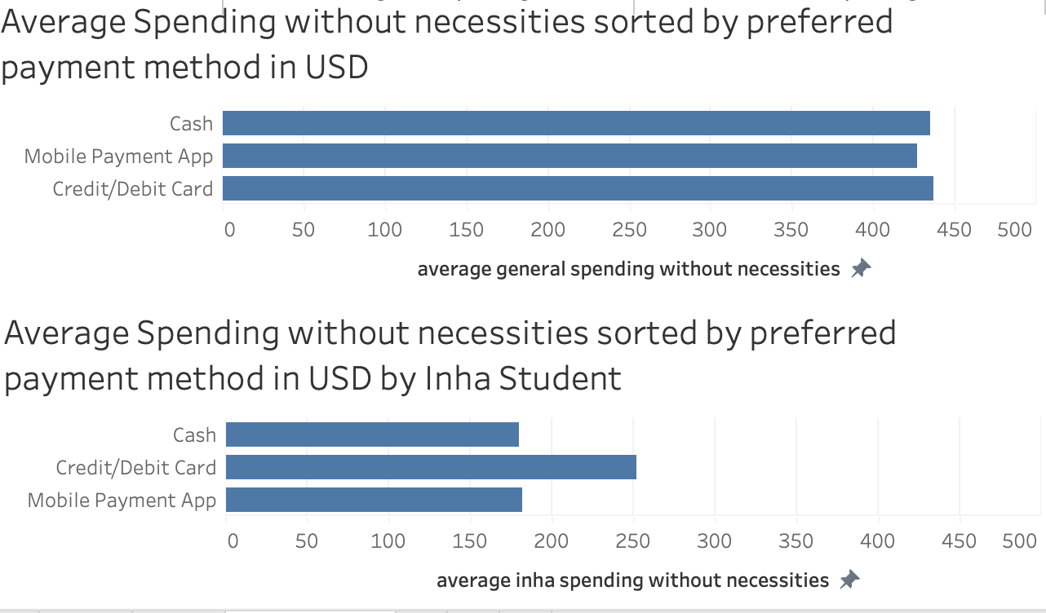
Results:
-> not a big difference between paying methods
-> Inha students spend slightly more money ($252 vs. $180 & $181) when using Credit/Debit Card

Slide 14
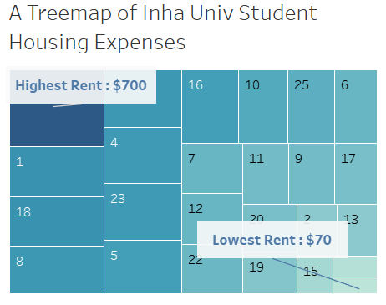
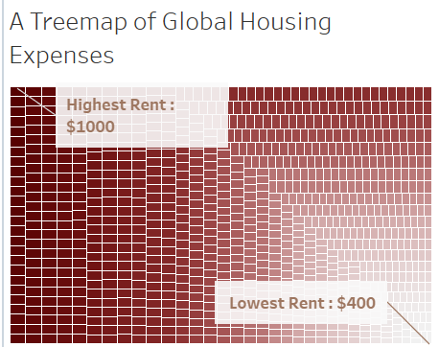
Maximum & Minimum Rental Prices Comparison

Slide 15
Income Vs Rent ratio to calculate Affordability
Objective:
To compare the housing expenses between Inha University and other universities to assess the affordability of housing for students at our university relative to others.
Calculation:
Income-to-Rent Ratio=(Monthly Income + Financial Aid) / Monthly Rent
Note: All information is based on the monthly rate and in USD.
Rationale for Using a Ratio Instead of Direct Rent Comparison:
Given the geographical diversity of the data, a direct comparison of rent prices would be unfair.
For instance, although housing costs are relatively lower in our country(Burma) compared to South Korea, our average hourly wage is approximately $2.77, whereas it is $7.21 in South Korea. This discrepancy makes housing relatively more affordable in South Korea despite cheaper rental prices.

Slide 16
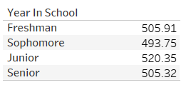
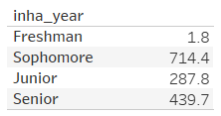
Results
Global Data
Inha Data
Others : The income-to-rent ratio remains relatively constant across all four years, with minor variations of approximately $10.
Inha University Data: The income-to-rent ratio for freshmen is notably lower compared to other academic years.
Potential Explanations:
International Students:The dataset predominantly consists of international students at Inha University.
These students may face challenges in securing part-time employment upon their initial arrival in Korea.
First-Year Challenges:Freshmen often lack the requisite knowledge and experience to identify affordable housing options.

Slide 17
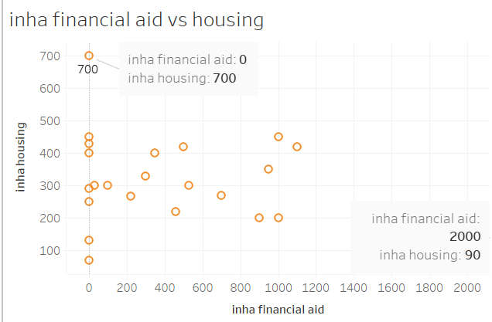
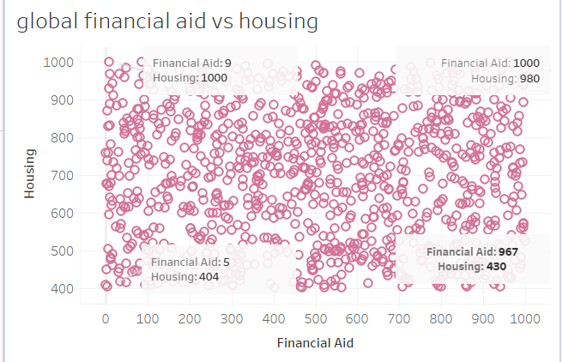
Housing vs Financial Aid
Objective : Understanding this correlation can shed light on how well financial aid programs are supporting students in covering their housing expenses. If the financial aid is consistently less than their housing costs, it indicates that students may struggle to afford housing without additional income sources.

Slide 18
Conclusion
In term of housing prices, the amount spent by Inha University students is relatively similar to global rental prices with a medium of $300~$500 per month.
According to the Income-rent ratio, Inha students encounter financial hardship in their first year, and the second years(sophomore) students have the best financial situation.
The trend is fluctuated throughout 4 years so the best approach for this situation is that students should take enough money from their hometown to cover up the expenses in the first year.
The sophomores might have a lot of disposable money but they should save up ahead for the lower income in the next year.
However, the financial burden would not be as imminent if they already gone through the first year.

Slide 19
Conclusion
In conclusion, the amount of money our student spend on Housing is nearly 60% of total income ( Calculated from average) meanwhile the education expense is barely 0.5%.
Monthly Income : $497, Housing :$316.72 , Food : $224.56, Transportation : $45, Education : $22, Entertainment : $106, Personal Care : $49, Tech tool : $28, Health Care : $41, Miscellaneous cost : $55.4

Slide 20
Thank you for your attention!
Q&A?

